Slide 1
Regression in numerical analysis
Course Instructor
Engr. Zoobia Zeeshan
zoobiazeeshan.bukc@bahria.edu.pk

Slide 2
Linear Regression
Linear regression predicts the relationship between two variables by assuming a linear connection between the independent and dependent variables.
It seeks the optimal line that minimizes the sum of squared differences between predicted and actual values.
Applied in various domains like economics and finance, this method analyzes and forecasts data trends.
It can extend to multiple linear regression involving several independent variables and logistic regression, suitable for binary classification problems
In a simple linear regression, there is one independent variable and one dependent variable.
The model estimates the slope and intercept of the line of best fit, which represents the relationship between the variables.
The slope represents the change in the dependent variable for each unit change in the independent variable, while the intercept represents the predicted value of the dependent variable when the independent variable is zero.

Slide 3
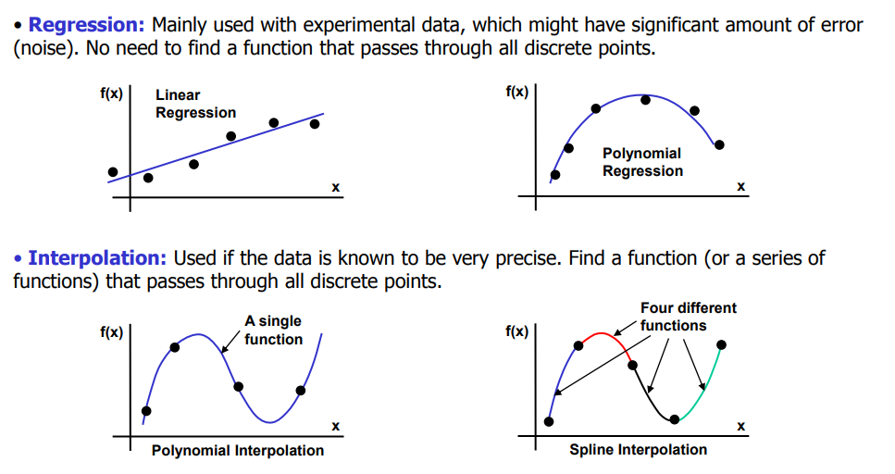

Slide 4
Regression Calculation
To calculate best-fit line linear regression uses a traditional slope-intercept form which is given below,
Y_{i} = β₀ + β₁X_{i}
where
Y_{i} = Dependent variable,
β₀ = constant/Intercept(the value of Y when x=0),
β₁ = Slope/Intercept(how much Y changes for a unit change in X),
X_{i} = Independent variable.
This algorithm explains the linear relationship between the dependent(output) variable y and the independent(predictor) variable X using a straight line Y= B₀ + B₁ X.

Slide 5
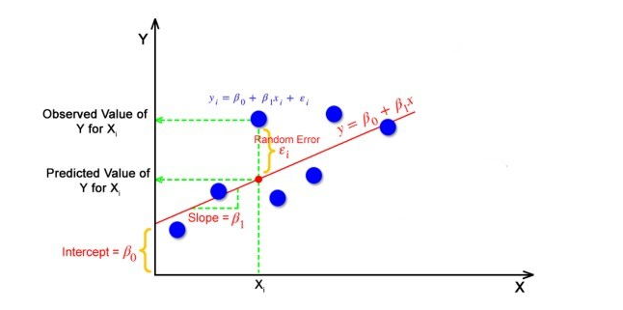
1. The goal of the linear regression algorithm is to get the best values for B₀ and B₁ to find the best fit line.
2. The best fit line is a line that has the least error which means the error between predicted values and actual values should be minimum.

Slide 6
Random Error(Residuals)
In regression, the difference between the observed value of the dependent variable(y_{i}) and the predicted value(predicted) is called the residuals.
ε_{i} = y_{predicted} – y_{i}
where y_{predicted} = B₀ + B₁ X_{i}
In simple terms, the best fit line is a line that fits the given scatter plot in the best way. Mathematically, the best fit line is obtained by minimizing the Residual Sum of Squares(RSS).

Slide 7

Cost Function
The cost function helps to work out the optimal values for B₀ and B₁, which provides the best fit line for the data points.
In Linear Regression, generally Mean Squared Error (MSE) cost function is used, which is the average of squared error that occurred between the y_{predicted} and y_{i}.
We calculate MSE using simple linear equation y=mx+b:
Using the MSE function, we’ll update the values of B₀ and B₁ such that the MSE value settles at the minima.
These parameters can be determined using the gradient descent method such that the value for the cost function is minimum.

Slide 8
Steps to Understand Linear Regression
Plot the Data: First, visualize your data by plotting it on a graph to see if it looks like a straight line. The goal of linear regression is to fit a line that best represents the data.
Find the Best-Fit Line: The line that best fits the data is the one that minimizes the "error" (the difference between the observed values and the predicted values). This is done using a method called Least Squares.
Equation of the Line: After fitting the line, we have the equation of the line, which we can use to predict Y for new values of X.

Slide 9
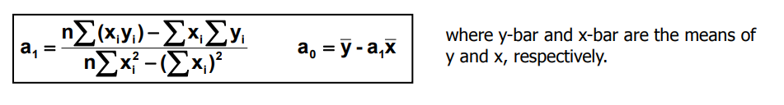
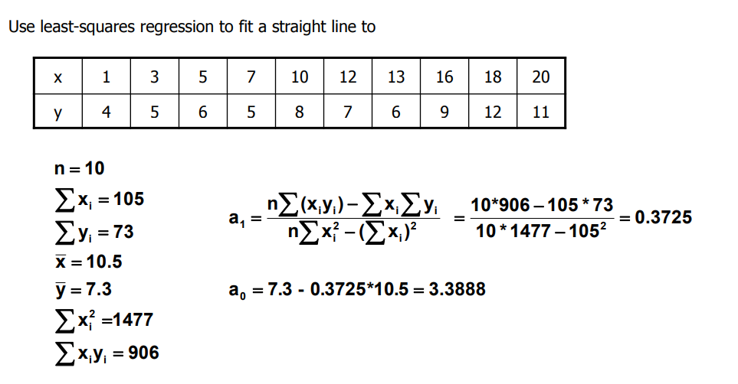

Slide 10
Topic to Read with Example
Cost Function

